Slide 1
background
The CSS background properties are used to add background effects for elements

Slide 2
What is the properties for background?
background-color
background-image
background-repeat
background-attachment
background-position
background (shorthand property)

Slide 3
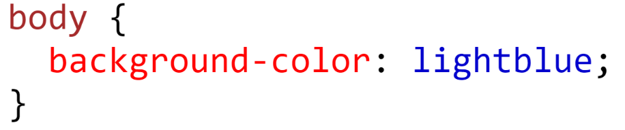

Background-color
The background-color property specifies the background color of an element
Syntax
With CSS, a color is most often specified by:
-a valid color name - like "red"
-a HEX value - like "#ff0000"
-an RGB value - like "rgb(255,0,0)"
Output

Slide 4
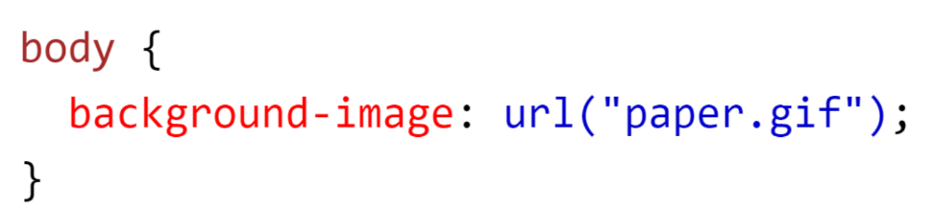
Background-image
The background-image property specifies an image to use as the background of an element.
By default, the image is repeated so it covers the entire element.
Syntax
With CSS, url() function

Slide 5
Background-repeat
By default, the background-image property repeats an image both horizontally and vertically.
Some images should be repeated only horizontally or vertically, or they will look strange, like this
Types of background-repeat
Repeat
Repeat-x
Repeat-y
No-repeat

Slide 6




Value of Background-repeat
Repeat
The background image is repeated both vertically and horizontally.
Repeat-x
The background image is repeated only horizontally
Repeat-y
The background image is repeated only vertically
No-Repeat
The background-image is not repeated. The image will only be shown once

Slide 7
Background-attachment
The background-attachment property specifies whether the background image should scroll or be fixed.
Values of background-attachment
Scroll
The background image will scroll with the page. This is default
Fixed
The background image will not scroll with the page

Slide 8
Background-position
The background-position property is used to specify the position of the background image.
Types of background-position(direction)
left top
left center
left bottom
right top
right center
right bottom
center top
center center
center bottom
x% y%
The first value is the horizontal position and the second value is the vertical
Example
background-position: 10% 40%;
X pos y pos
The first value is the horizontal position and the second value is the vertical,Units can be pixels (0px 0px) or any other CSS units
Example
background-position: 50px 100px;

Slide 9
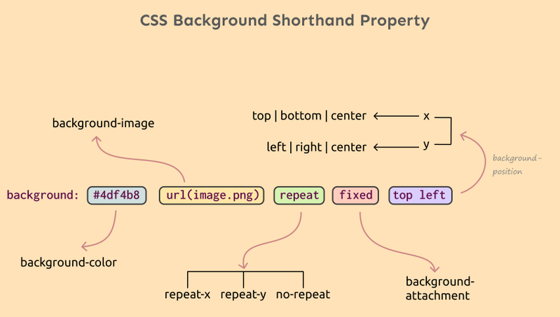
Background-Shorthand
To shorten the code, it is also possible to specify all the background properties in one single property. This is called a shorthand property.
We can explain it by:

Slide 10
Margin
The CSS margin properties are used to create space around elements, outside of any defined borders.

Slide 11
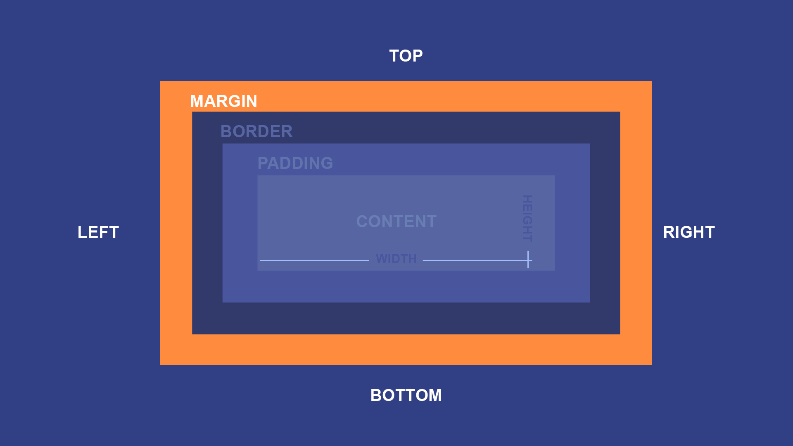
What is the properties for margin?
Margin-top
Margin-right
Margin-bottom
Margin-left
Margin (shorthand property)

Slide 12
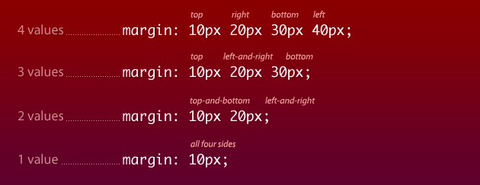
Margin-shorthand
To shorten the code, it is possible to specify all the margin properties in one property.
The margin property is a shorthand property for the following individual margin properties:
Margin-top
Margin-right
Margin-bottom
Margin-left

Slide 13
Padding
The CSS Padding is used to create space around an element's content, inside of any defined borders.

Slide 14
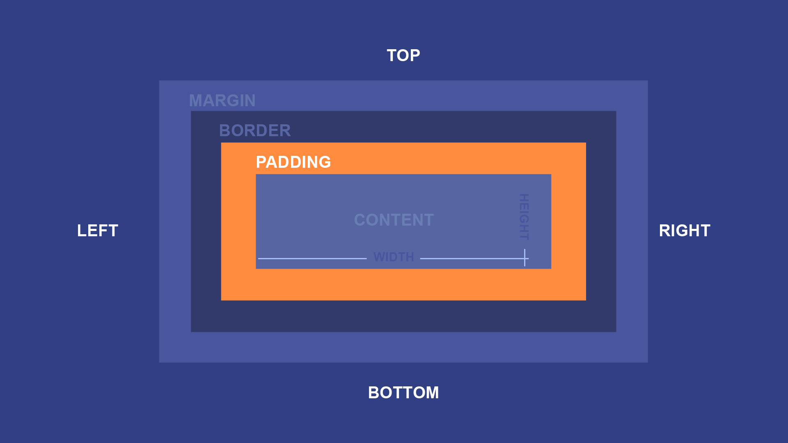
What is the properties for padding?
padding-top
padding-right
padding-bottom
padding-left
padding (shorthand property)

Slide 15
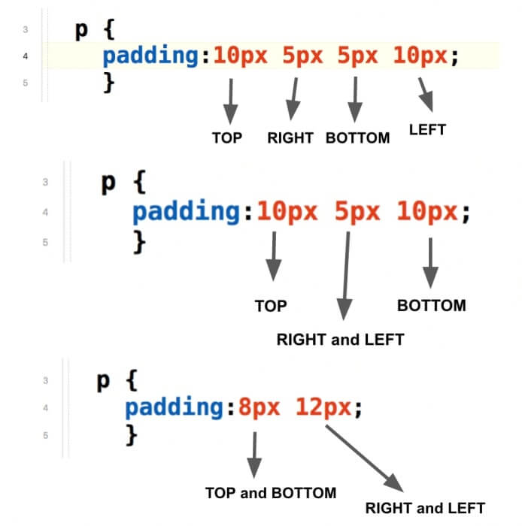
Padding-shorthand
To shorten the code, it is possible to specify all the padding properties in one property.
The padding property is a shorthand property for the following individual padding properties:
Padding-top
Padding-right
Padding-bottom
Padding-left

Slide 16
Border
The CSS border properties allow you to specify the style, width, and color of an element's border.

Slide 17
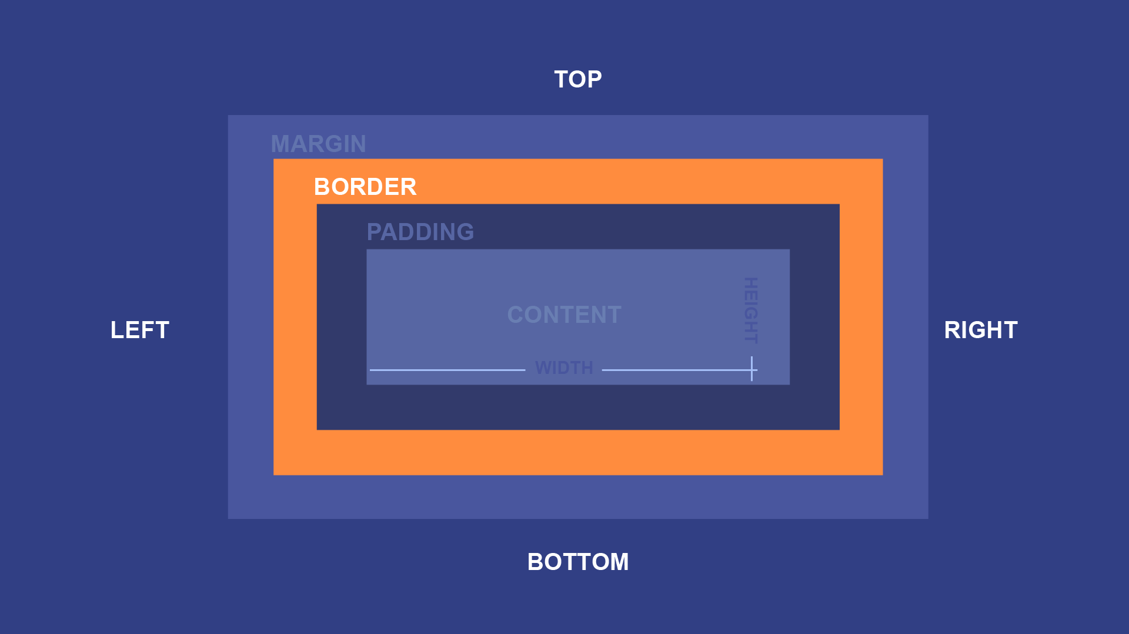
What is the properties for border?
Border-Style
Border-width
Border-Color
Border-side
-border-left
-border-right
-border-top
-border-bottom
Border (shorthand property)

Slide 18
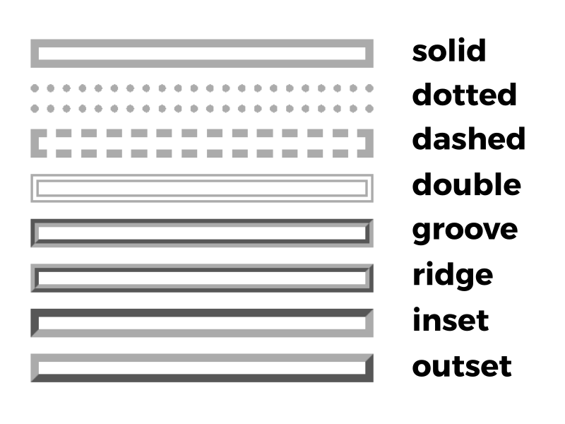
Border-style
The border-style property specifies what kind of border to display.
Value of border-style

Slide 19
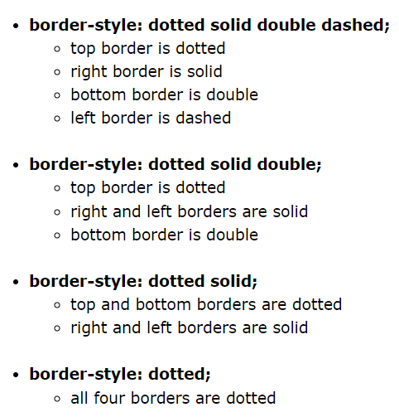
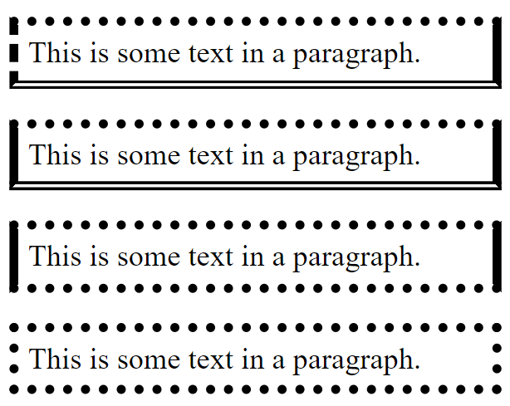
Border-style-shorthand
The border-style property can have from one to four values (for the top border, right border, bottom border, and the left border).

Slide 20
Border-width
The border-width property specifies the width of the four borders.
Value of border-width
The width can be set as a specific size (in px, pt, cm, em, etc) or by using one of the three pre-defined values: thin, medium, or thick

Slide 21
Border-color
The border-color property is used to set the color of the four borders.
Value of border-color
Name - specify a color name, like "red"
HEX - specify a HEX value, like "#ff0000"
RGB - specify a RGB value, like "rgb(255,0,0)"
HSL - specify a HSL value, like "hsl(0, 100%, 50%)"

Slide 22
Border-sides
By the border-side We can apply anything by the border and use it in any side for border and make it differently from other sides
Property of border-side
-border-left
-border-right
-border-top
-border-bottom

Slide 23
Border-shorthand
To shorten the code, it is possible to specify all the border properties in one property.
The border property is a shorthand property for the following individual border properties:
border-width
border-style (required)
border-color

Slide 24
Outline
An outline is a line that is drawn around elements, OUTSIDE the borders, to make the element "stand out".

Slide 25
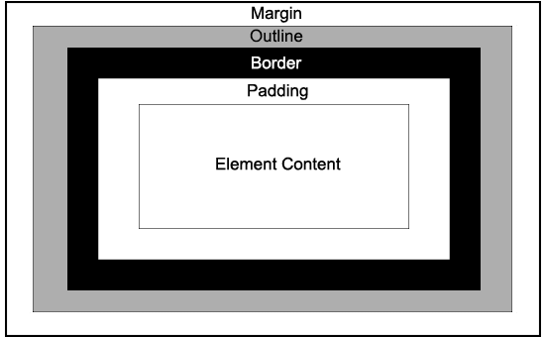
What is the properties for Outline?
Outline-Style
Outline-width
Outline-Color
Outline (shorthand property)
Outline-offset

Slide 26
Outline-style
The outline-style property specifies the style of the outline, and can have one of the following values:
Value of ouline-style

Slide 27
Outline-width
The outline-width property specifies the width of the four outline.
Value of outline-width
The width can be set as a specific size (in px, pt, cm, em, etc) or by using one of the three pre-defined values: thin(1 px), medium(3 px), or thick(5 px)

Slide 28
Outline-color
The outline-color property is used to set the color of the four outline.
Value of outline-color
Name - specify a color name, like "red"
HEX - specify a HEX value, like "#ff0000"
RGB - specify a RGB value, like "rgb(255,0,0)"
HSL - specify a HSL value, like "hsl(0, 100%, 50%)"

Slide 29
Outline-shorthand
To shorten the code, it is possible to specify all the outline properties in one property.
The outline property is a shorthand property for the following individual border properties:
outline-width
outline-style (required)
outline-color

Slide 30

Outline-offset
The outline-offset property adds space between an outline and the edge/border of an element. The space between an element and its outline is transparent.
Value of outline-offset
The offset can be set as a specific size (in px, pt, cm, em, etc)

